Slide 1
Improving the Care of Serious Illness at [Name of Org]
The Value of CAPC Membership
YOU R LOGO H ER E

Slide 2
What is CAPC?
For over two decades, the Center to Advance Palliative Care (CAPC) has been helping health care professionals and organizations better meet the needs of seriously ill patients and their families.
Clinical, administrative, and system leaders turn to CAPC to learn game-changing innovations, master proven best practices, hone clinical and organizational skills, and elevate the care and treatment of seriously ill patients.

Slide 3
CAPC Reach and Impact
CAPC’s long track record of success includes:
→ 1,700 member organizations
→ Serving 120,000+ professionals
→ 16 of U.S. News’s top 20 Honor Roll hospitals as members
→ More than 500 online courses and tools
→ More than 1 million online courses taken

Slide 4
How can CAPC help [Name of Org]?
CAPC provides the specific training, tools, and technical assistance [Name of Org] needs to cement our [leadership/growth] in palliative care and the care of serious illness overall—to ensure we remain at the forefront of higher- quality, more cost-effective care.
The cost is low, the value is extraordinary.

Slide 5
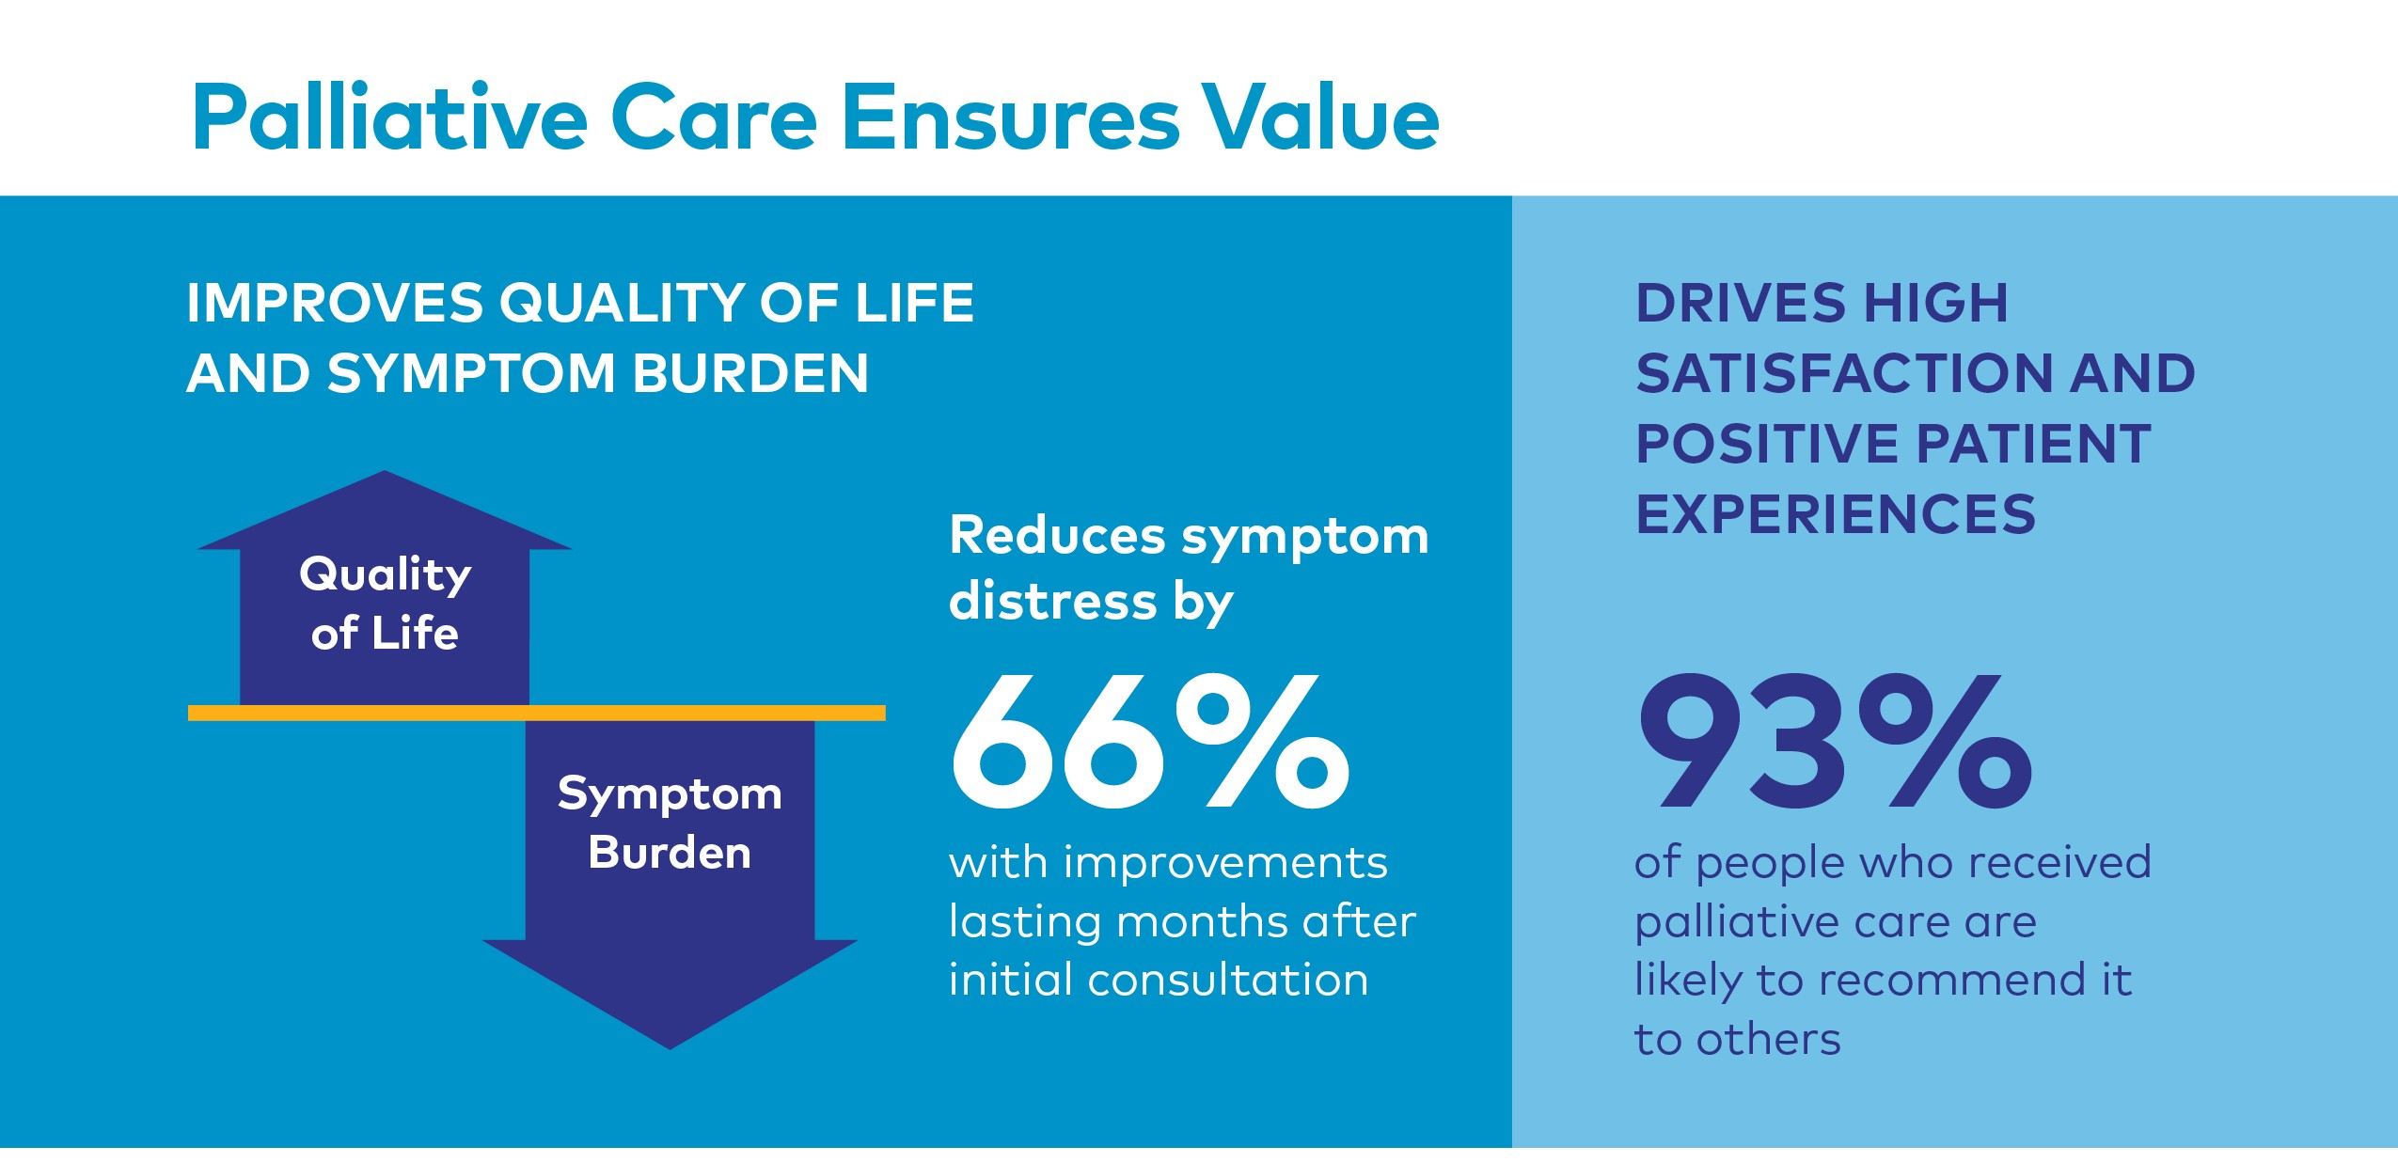

Slide 6
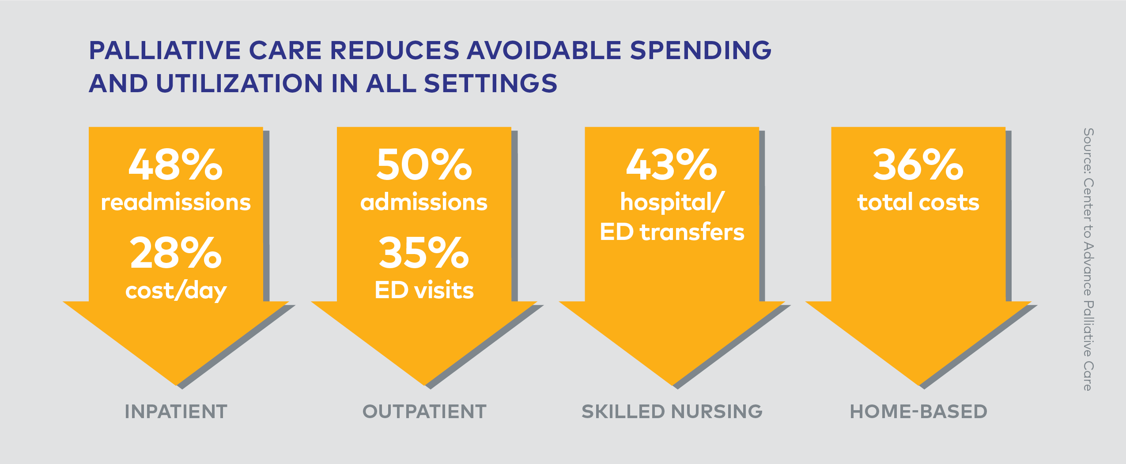

Slide 7
The CAPC
Advantage
→ Grow and sustain our palliative care program
→ Provide clinical training─online, case-based, interactive courses─for all disciplines and all specialties across the organization
→ Raise the bar through hundreds of tools, tutorials, case studies, and monographs
→ Improve our palliative care program operations
and help us onboard new staff
→ Improve consistency of practice
→ Receive CE credits and ABIM MOC credits (included with membership)
→ Consult with experts in real time
→ Measure for success
CAPC membership ensures the successful scaling of care directed to serious illness.
Access is for all staff throughout our organization.
It’s the roadmap that will help us…

Slide 8
Our Return on Investment
Just one CAPC membership fee covers the cost of:
→ Clinical and operational training
→ Tools and technical assistance
→ Consulting with national leaders and experts
→ Briefings, webinars, and expert articles
→ CE credits and ABIM MOC credits
→ For our entire staff
Access to all resources is included in membership and is unlimited for all staff throughout [Name of Org].

Slide 9

Consider This

Slide 10
1
Normally, the average
cost of 1 CME credit for physicians = $75–$150.
The average cost of
1 CNE credit for nurses
= $50–$100.
Since CAPC membership is at a flat fee of [insert your fee] for UNLIMITED ACCESS to courses by all staff, the cost per credit is substantially lower.
2
CAPC also offers 25 webinars and briefings each year, FREE for all members.
The usual cost for webinars is $50–$75
per person.
3
CAPC members have access to Virtual Office Hours almost every day
of the week.
Virtual Office Hours are small-group consulting calls with national experts.
Value: Priceless

Slide 11
Again, why is CAPC membership important?
→ It will help us provide the best care to our patients living with serious illness.
→ Our entire organization will have access to clinical training and CE credits.
→ CAPC is the trusted engine fueling the success of palliative care teams, and the care of serious illness, throughout the country.
→ Our team and organization-wide staff will become part of a network of outstanding organizations dedicated to improving the care of serious illness.
→ We will have direct access to leaders, innovators, collaborators, and partners across the continuum of care.
→ We will foster more meaningful professional and patient connections, cross-fertilize new ideas, and ensure system-wide consistency of practice.
→ We will be better positioned to improve our bottom line.

Slide 12
Together with CAPC, we can change the quality of care we deliver to seriously ill patients and their families.
It’s right for our patients and families. It’s right for [Name of Org].

Slide 13
Thank you.
Name Title email phone
Please go to capc.org to learn more about CAPC, or feel free to contact us at [insert your info].
Y O U R L O G O H E R E

